Slide 1
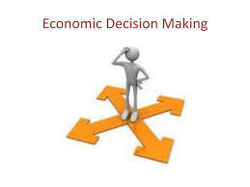

Slide 2


Slide 3
Meaning and Definitition
Nature
Scope & Significance
Uses of Managerial Economics.
Role and Responsibilities of Managerial Economist.
Theory of the Firm.
Firm and Industry.
Objectives of the firm, alternate objectives of firm.
Managerial theories:
Baumol’s Model
Marris’s model of growth maximization.
Williamson’s model of managerial discretion.

Slide 4
Meaning: Managerial Economics applies economic theory to business decision making. Managerial Economics applies microeconomic theory, quantitative techniques and managerial judgment to business decision making. It translates economic concepts (demand, cost, pricing, optimization) into practical advice for managers who must allocate resources to achieve organizational objectives.
It’s economics with a business action orientation, “how to use scarce resources to achieve firm goals.” It serves as a bridge between Economics and Business Management
Definition: According to Spencer & Siegelman, “Managerial Economics maybe defined as the integration of economic theory with business practices for the purpose of facilitating decision-making and forward planning by management”
Example: Determining pricing or production levels using demand and cost analysis.

Slide 5
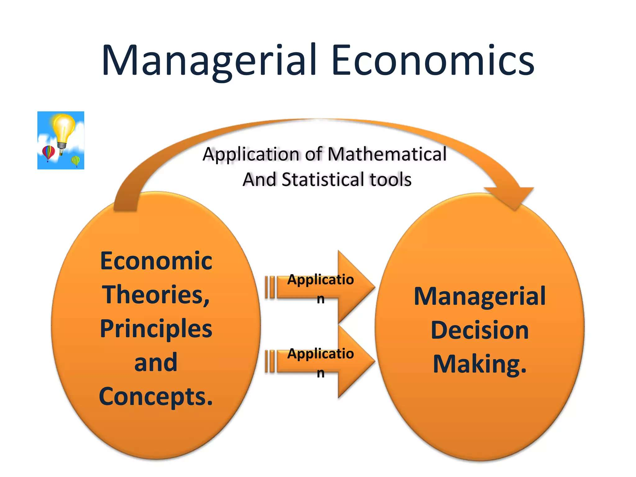

Slide 6
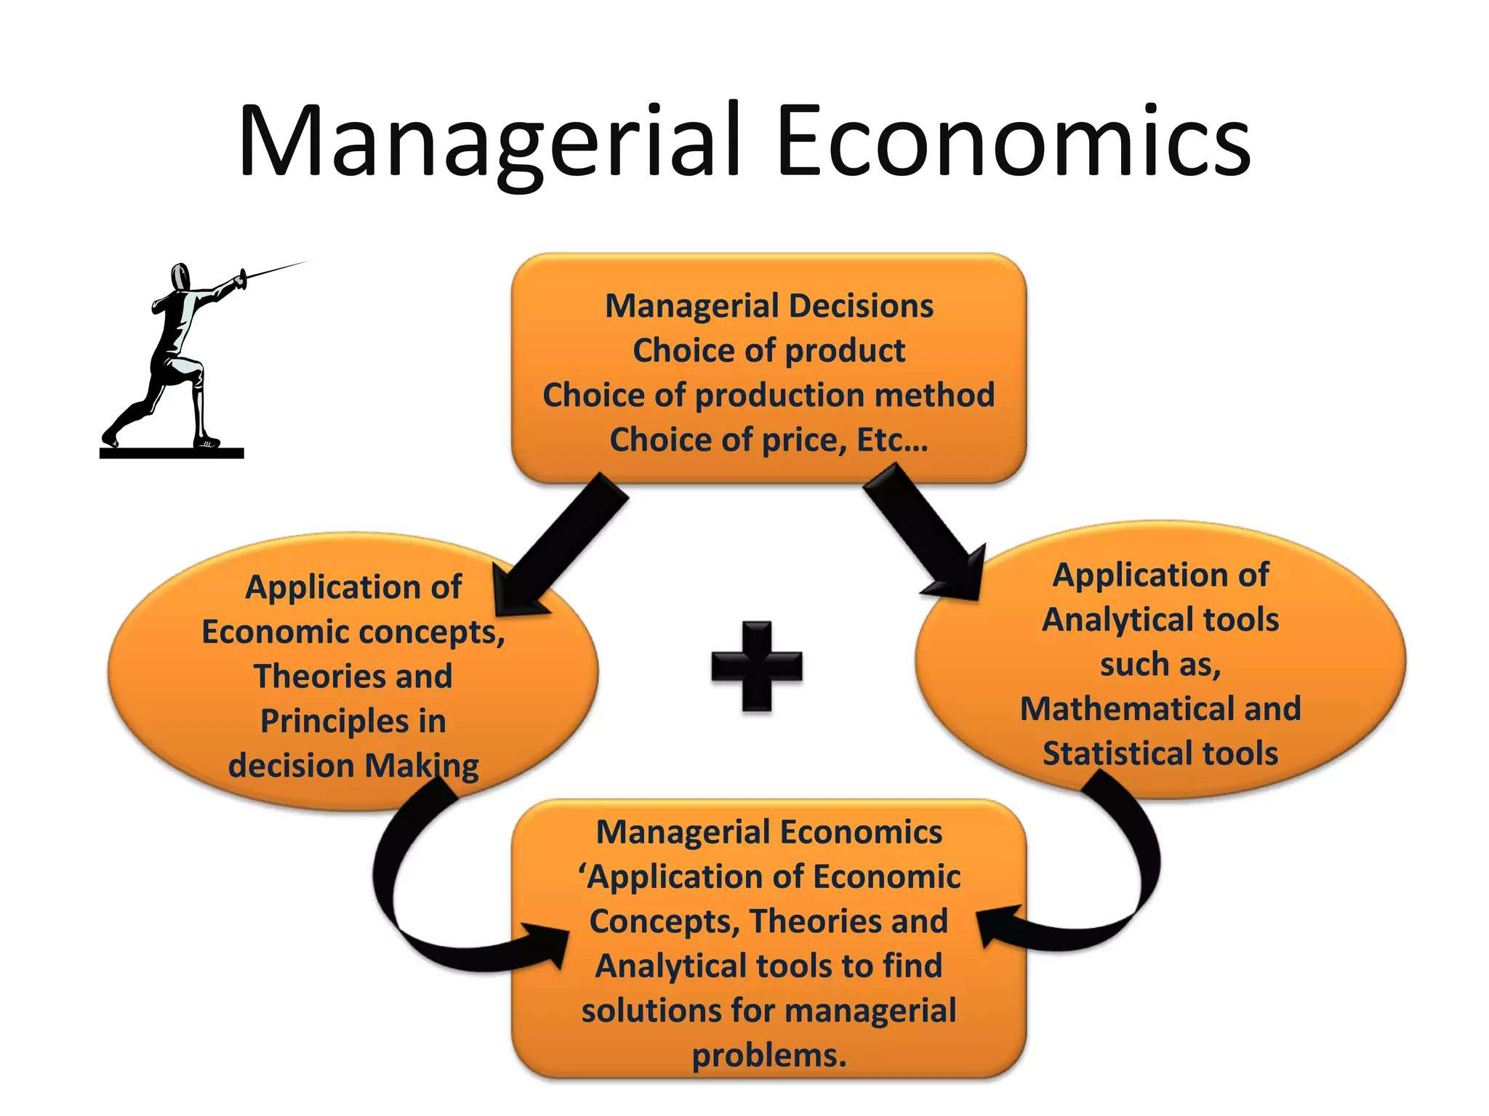

Slide 7
Nature of Managerial Economics
Microeconomic in nature: Concentrates on decisions at the firm or consumer level (not macro aggregates). Primarily concerned with the individual firm and its decision-making. Example: Determining the price of a particular product in a competitive market
Normative science: What managers ought to do…… recommends best choices (not merely describing what happens). Example: “The firm should reduce prices by 5% to increase market share” — a normative suggestion.
Practical application of theory: Focuses on practical application rather than theoretical abstraction. Deals with real-world business problems

Slide 8
4.Decision oriented: Helps managers choose the best course of action out of several alternatives. Example: Deciding whether to launch a new product based on estimated costs, demand, and profits.
5.Interdisciplinary: Managerial Economics is an interdisciplinary field that combines concepts from economics, mathematics, statistics, accounting, finance, management, operations research, and psychology (especially behavioral aspects). It blends economic theory with quantitative tools to support business decision-making. Example: A manager uses statistics to predict sales and finance principles to evaluate investment returns.
6.Future Oriented: It deals with future planning and forecasting. Managers use economic principles to predict future market trends, demand, and cost conditions. Example: Estimating future demand for electric vehicles before investing in new production facilities.

Slide 9
Scope of Managerial Economics
1. Demand Analysis & Forecasting: This involves studying consumer demand for a product how much customers are willing to buy at different prices and predicting future demand. It helps firms to decide how much to produce, what price to set, and when to expand production.
Example:
A smartphone company analyzes past sales, current market trends and customer preferences to forecast demand for its new model. If demand is expected to rise by 20% during the festive season, the firm increases production in advance.
2. Production & Cost Analysis: This deals with understanding the best way to use inputs (labour, machinery, raw material) to produce goods efficiently and at minimum cost. It helps managers to decide the optimal production level and cost-saving strategies.

Slide 10
Example:
A bakery compares the cost of making 500 cakes per day vs. 800 cakes per day. It finds that producing in bulk reduces average cost per cake due to economies of scale. So, the firm increases output to lower cost.
3. Pricing Decisions: Pricing is one of the most important managerial decisions. It involves deciding how much to charge for a product based on demand, cost, competitors, and market structure. Pricing affects sales volume, profit, and competition.
Example:
Uber uses dynamic pricing fares increase during peak hours when demand is high. This is a managerial economic decision based on demand and supply.

Slide 11
4. Profit Management: Profit management involves determining how to maximize profit by balancing revenue and costs and planning for both short-term and long-term profitability. Profit is the key goal of any business.
Example:
A restaurant sees that weekday profits are low. It introduces weekday discount offers to attract more customers and increase profit.
5. Capital Management: This refers to decisions related to investment and finance. How much money is needed, Where to invest, and the best source of funds (loan, equity, retained earnings). Proper capital allocation ensures smooth business operations and future growth.
Example:
A startup decides whether to borrow from a bank or raise funds from investors to expand its business. Managerial economics helps compare interest costs, ownership dilution, risk, etc.

Slide 12
Significance of Managerial Economics
Improves Decision Quality: Managerial Economics provides scientific tools, data analysis and economic logic to help managers make better decisions instead of relying on guesswork or intuition.
Example: A company uses demand forecasting before launching a new product. Instead of randomly setting a price, it studies consumer demand, competitor pricing and cost structure to choose the most profitable price.
Minimizes Risk and Uncertainty: Business decisions always involve risk (future is uncertain). Managerial Economics uses techniques like probability analysis, forecasting, and risk models to reduce uncertainty.

Slide 13
Example: An airline uses demand prediction models to decide how many seats to offer at discounted prices. This reduces the risk of empty seats (loss) or overbooking (customer dissatisfaction).
Facilitates Planning and Control: It helps managers plan future activities (production, pricing, staffing, etc.) and control business performance by comparing actual results with planned results.
Example: A biscuit manufacturing company estimates monthly production based on demand forecasts. If actual sales are lower, it reduces production to control inventory cost.
Optimizes Resource Use: Managerial Economics helps firms use limited resources (like money, manpower, raw materials, time) in the most efficient way to avoid wastage and maximize output.
Example: A hospital uses cost-benefit analysis to decide whether to buy a new MRI machine or outsource scanning services, ensuring funds are used efficiently.

Slide 14
Enhances Coordination: It aligns different departments (production, marketing, finance, HR) by providing common economic logic and data-based decision-making.
Example: Before launching a new car model, the marketing team (pricing), production team (quantity), finance team (budget), and HR team (staffing) all work using a common sales forecast prepared using managerial economics tools.

Slide 15
Uses of Managerial Economics
Demand Forecasting: Managerial Economics helps businesses to estimate future demand for their products or services so they can plan production, inventory, staffing, and marketing.
Example:
Starbucks studies consumer preferences, seasonal trends, income levels, and past sales data to forecast how many cups of coffee will sell in a particular city. This helps them decide how much coffee to buy, how many staff to hire, and whether to open more outlets.
Production Planning: It helps firms to decide what to produce, how much to produce, and how to produce using the most efficient combination of labor and technology.
Example:
A car manufacturing company uses economic cost analysis to decide whether to invest in automation (robots) or continue using manual labor. If automation reduces long-term cost, managerial economics supports the decision with cost-benefit analysis.

Slide 16
Investment and Capital Budgeting Decisions: It helps managers to evaluate long-term investments using tools like Net Present Value (NPV), Internal Rate of Return (IRR), and Payback Period.
Example:
A company deciding whether to build a new factory compares the NPV of investing ₹50 crore today with the future profits it will generate over 10 years. If NPV is positive and IRR is higher than cost of capital, the project is approved.
Pricing Policy: Managerial Economics guides pricing strategies by analyzing demand elasticity, competition, cost, and customer behavior.
Example:
Netflix charges different subscription prices in different countries. In India, the price is lower than in the US because of different income levels and competition. This regional pricing strategy is based on economic analysis of willingness to pay.

Slide 17
Profit Planning and Management: Managerial Economics helps firms analyze how much they need to sell to earn profit and avoid losses using tools like break-even analysis.
Example:
A bakery calculates that it must sell 2,000 cupcakes per month to cover its fixed and variable costs (break-even point). Selling more than 2,000 earns profit; less than 2,000 results in loss. This helps in pricing, sales targets, and production planning.
Policy Formulation and Business Strategy: Managerial economics helps in designing internal business policies related to production, pricing, marketing, and inventory control. It ensures policies are data-driven and economically sound.
Example:
A company revises its pricing policy in response to inflation or changes in tax rates.

Slide 18
Resource Allocation: Resources are always limited; managerial economics helps allocate them optimally. It ensures the highest return on investment by choosing the best combination of inputs.
Example:
An airline allocates aircraft to profitable routes using cost and demand analysis.
Evaluation of Government Policies: Managerial economics helps firms evaluate and adapt to such policies effectively.
Example:
A manufacturing firm adjusts its production plan after a hike in import duties on raw materials.
Performance Appraisal and Control: It helps assess the performance of different departments or projects using cost-benefit and productivity analysis.
Example:
A company compares departmental profit margins to evaluate manager performance.

Slide 19
Role & Responsibilities of Managerial Economist
Demand Forecasting: Predicts future demand for the company’s products and services. It helps in production, pricing, staffing, and inventory decisions. Example: Forecasting how many smartphones will be sold next quarter.
Cost & Production Analysis: Studies cost behavior (fixed, variable, marginal costs). Suggests the most economical level of production. Example: Advising whether to produce in-house or outsource.
Pricing & Market Strategy: Helps in fixing product prices using concepts like elasticity, competition, and market structure.

Slide 20
Risk Analysis: Evaluates business risks (price risk, demand risk, interest rate risk, etc.). Uses tools like probability, scenario analysis, sensitivity analysis. Example: Helping the company hedge against raw material price fluctuations.
Capital Budgeting: Evaluates investment proposals using NPV, IRR, payback period, etc. Example: Deciding whether to invest in a new factory or new technology.
Policy Evaluation: A Managerial Economist evaluates the impact of government policies, regulations, and internal company policies on business operations and profitability.
Profit Planning: Uses break-even analysis, cost-volume-profit analysis, and profit forecasting. Example: Calculating minimum sales needed to avoid loss.

Slide 21

Theory of the firm

Slide 22



Slide 23
A firm is a single business unit or organization engaged in producing or selling goods and services for profit. It is limited to one business organization. It takes decisions on production, pricing, and investment independently.
Where as an industry is a group of firms that produce similar or closely related products or services. It includes all firms producing similar goods/services. It represents the collective activities and market structure of all such firms.
Ex: Tata Motors Ltd., Maruti Suzuki Ltd., and Hyundai Motors are firms. The automobile industry includes all firms producing vehicles — Tata, Maruti, Hyundai, etc.
Example Type | Firm | Industry
Automobiles | Maruti Suzuki | Automobile Industry
Cement | ACC Ltd. | Cement Industry
Electronics | Samsung | Electronics Industry
Banking | HDFC Bank | Banking Industry

Slide 24
The traditional theory of the firm (based on classical economics) assumes that the main objective of a firm is profit maximization. It studies how firms make decisions on production, pricing, and profit.
However, in modern large corporations, ownership and management are separated. Managers are not owners to make most decisions. Hence, managerial theories of the firm were developed to explain managerial goals and decision-making when managers pursue objectives other than profit maximization, such as sales, growth or utility.
Objectives:
• Profit maximization (MC=MR)
• Sales maximization (Baumol)
• Growth maximization (Marris)
• Managerial utility maximization (Williamson)
• Satisficing behaviour (Simon)
• CSR objectives

Slide 25
Managerial Theories of the Firm
Managerial Theories focus on alternative objectives beyond profit:
1. Baumol’s Sales Maximization
2. Marris’s Growth Maximization
3. Williamson’s Managerial Discretion

Slide 26
Baumol’s Sales Maximization Model
William J. Baumol has explained about this theory. According to him, “every business firm aims at maximization. Maximize sales revenue with minimum acceptable profit." Managers rewards depend on sales, not profits. His theory is known as Sales Maximization or Revenue Maximization Theory.
In his article on the theory of Oligopoly presented a managerial theory of the firm based on the sales maximization.
Why do Businesses choose a Sales Maximization Objective?
What does Sales Maximization involve?

Slide 27
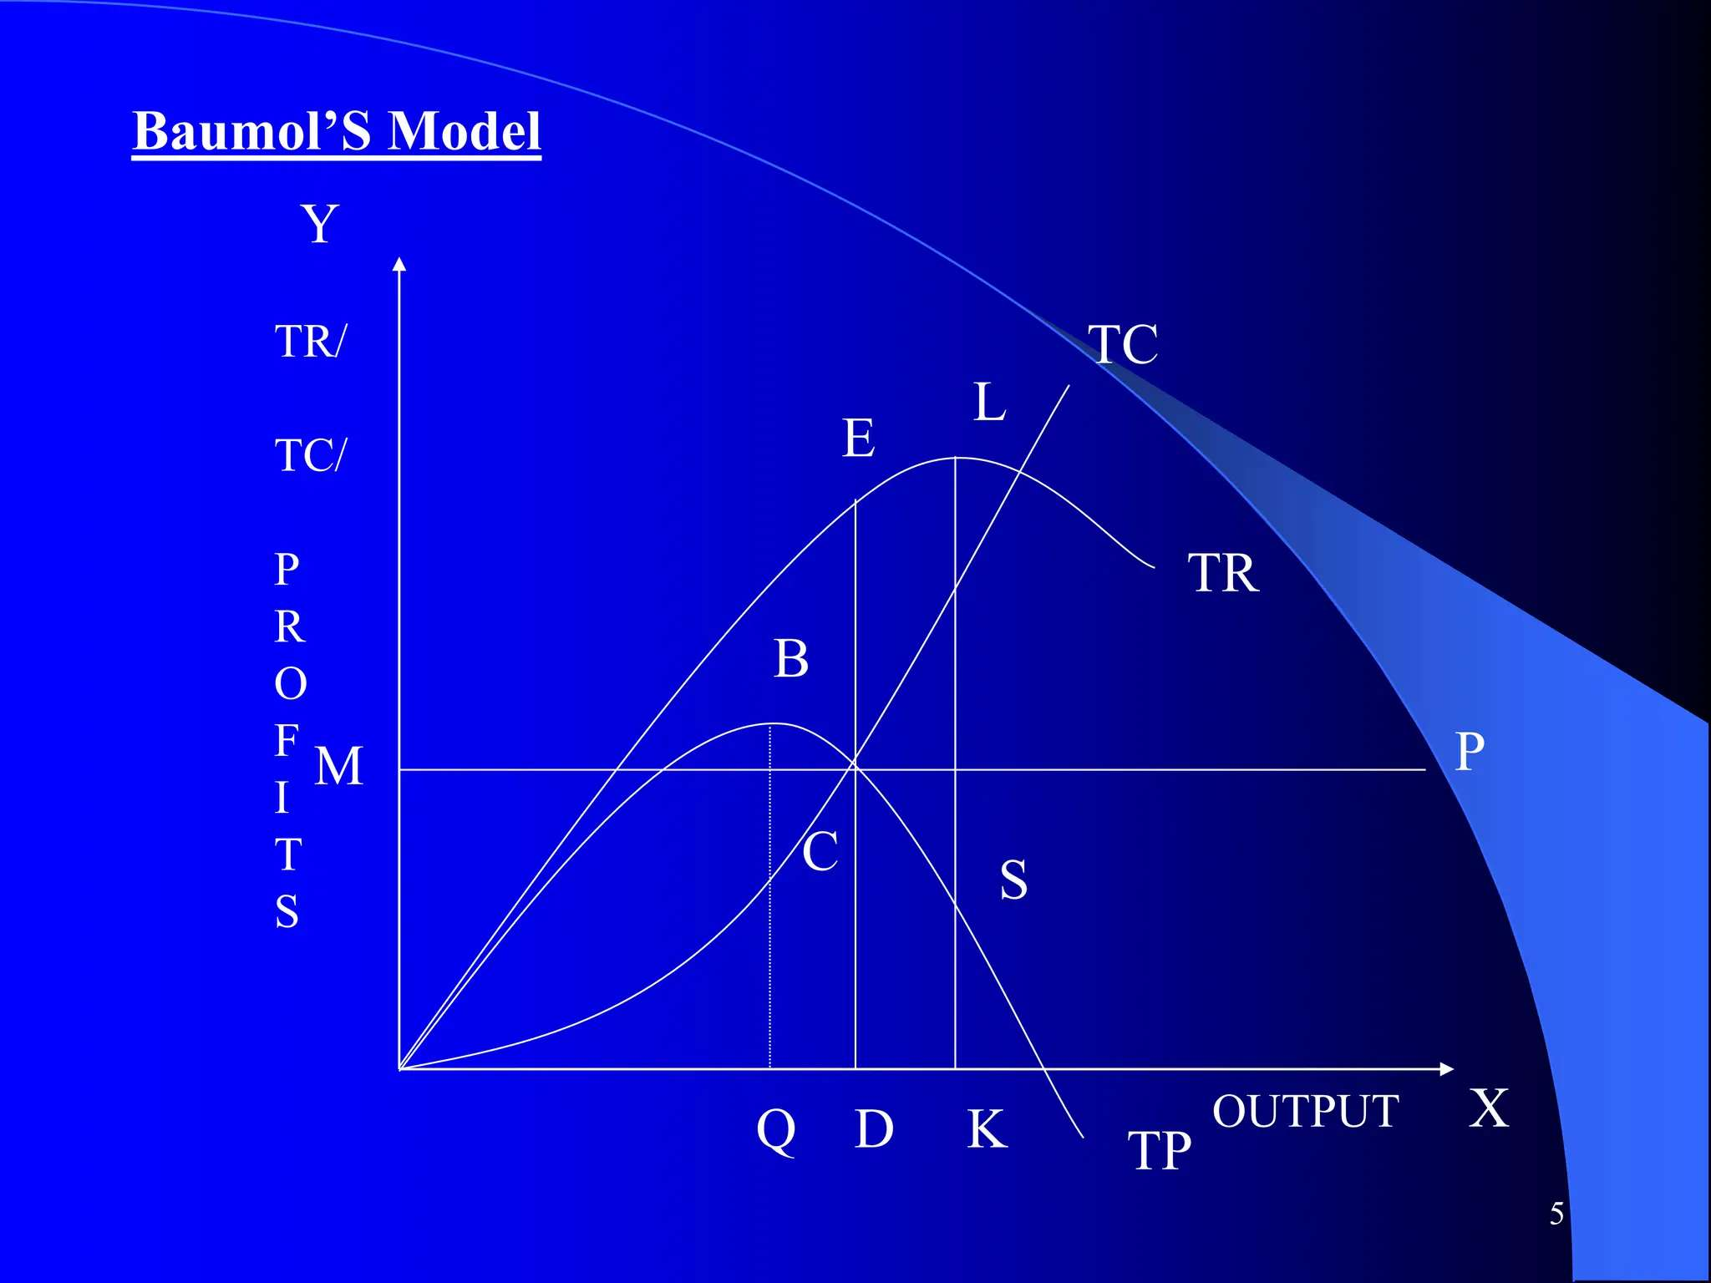
Notes:
Tc is total cost curve, TR is total revenue, TP is total profit, MP is minimum profit or profit constraint line, OQ is profit maximization output, OK is sale maximization output

Slide 28
In the above fig. TC is the total cost curve, TR the total revenue curve, TP the total profit curve and MP the minimum profit or profit constraint line.
The firm maximizes its profits at OQ level of output corresponding to the highest point В on the TP curve. But the aim of the firm is to maximize the sales rather than the profits.The sale maximization output is OK where the total revenue KL is maximum at the highest point of TR.
The sale maximization output OK is higher than the profit maximization output OQ. But the sales maximization is subject to the minimum profit constraint. If minimum profit constraint line is represented by line MP
The output OK will not maximise the sales as minimum profits OM are not being covered by the total profit KS. For sales maximisation the firm should produce that level of output which not only covers the minimum profits but also gives the highest total revenue consistent with it.

Slide 29
This level is represented by OD level of output where the minimum profits DC (=OM) are consistent with DE amount of total revenue at the price DE/OD, (i.e., total revenue/total output). Baumol’s model of sales maximisation points out that the profit maximisation output OQ will be smaller than the sales maximisation output OD, and price higher than under sales maximisation.
The reason for a lower price under sales maximisation is that both total revenue and total output are equally higher while under profit maximisation total output is much less as compared to total revenue. Imagine if QB is joined to TR in Figure 6. “If at the point of maximum profit”, writes Baumol, “the firm earns more profit than the required minimum, it will pay the sales maximiser to lower his price and increase his physical output.”

Slide 30
Assumption:
This theory is single period time horizon of the firm
Firms aims at maximizing its total sale and revenue in the long run subject to the profit constraint.
Firms minimum profit constraint is set competitively in terms of the current market value of its shares
Firms is oligopolistic whose cost are U-shaped and the demand curve is downward sloping.
Firms use advertising, sales promotions, and marketing to increase sales rather than just lowering prices.

Slide 31
Weaknesses / Limitations
Unrealistic assumption of minimum profit constraint
Ignores long-term profit sustainability
Overemphasis on sales, ignoring profitability
Assumes managers, not owners control the firm
Difficult to measure sales maximization
Ignores market competition and pricing reactions
Ignores internal constraints(more workers, machinery, higher WC)
Not suitable for small firms
No clear explanation of how sales maximization is achieved
Notes:
The model assumes managers will always maintain a minimum profit level, but in reality it is difficult to know what this minimum level is.
If a firm focuses too much on sales rather than profit:
✔ costs may rise
✔ profits may shrink
✔ long-term survival becomes uncertain
money value or
physical units

Slide 32
Marris’s Growth Maximization Model
Robin Marris in his book ‘The Economic Theory of Managerial Capitalism’ (1964) has developed a dynamic balanced growth maximizing model of the firm. He concentrates on the proposition that modern big firms are managed by managers and the shareholders are the owners who decide about the management of the firms.
The managers aim at the maximization of the growth rate of the firm and the shareholders aim at the maximization of their dividends and share prices. To establish a link between such a growth rate and the share prices of the firm, Marris develops a balanced growth model in which the manager chooses a constant growth rate at which the firm’s sales, profits, assets, etc. to grow at a same time.

Slide 33
If he chooses a higher growth rate, he has to spend more on advertisement and on R & D in order to create more demand and new products. Therefore he retain a higher proportion of total profits for the expansion of the firm. Consequently, profits to be distributed to shareholders in the form of dividends. If profits will be reduced then the share prices will fall. The threat of take-over of the firm will loom large among the managers.
As the managers are concerned more about their job security and growth of the firm they will choose that growth rate which maximizes the market value of shares and give satisfactory dividends to shareholders and also avoid the take-over of the firm. On the other hand, the owners (share­holders) also want balanced growth of the firm because it ensures fair return on their capital. Thus the goals of the managers may coincide with the owners of the firm and both try to achieve balanced growth of the firm.
Notes:
Retain- to keep or continue to have something; not to lose

Slide 34
There are two sets of goals
Owners (shareholders) aims at profits and market share
Managers aims at better salary, job security and growth
Both achieved by maximizing balanced growth of the firm.
Two types of constraints he explained in his theory. Those are:
Managerial constraints arise due to:
Limit to managers ability to manage and achieve optimum efficiency
Managers own job security
Financial constraints arise due to:
Conflict between managers own utility function and owners utility function
Um=f(salary, power, job security, status)
Uo=f(profit, capital, output, market share, public reputation)
However he claims that the two utility functions converge into one variable that study growth in the size of firm.

Slide 35
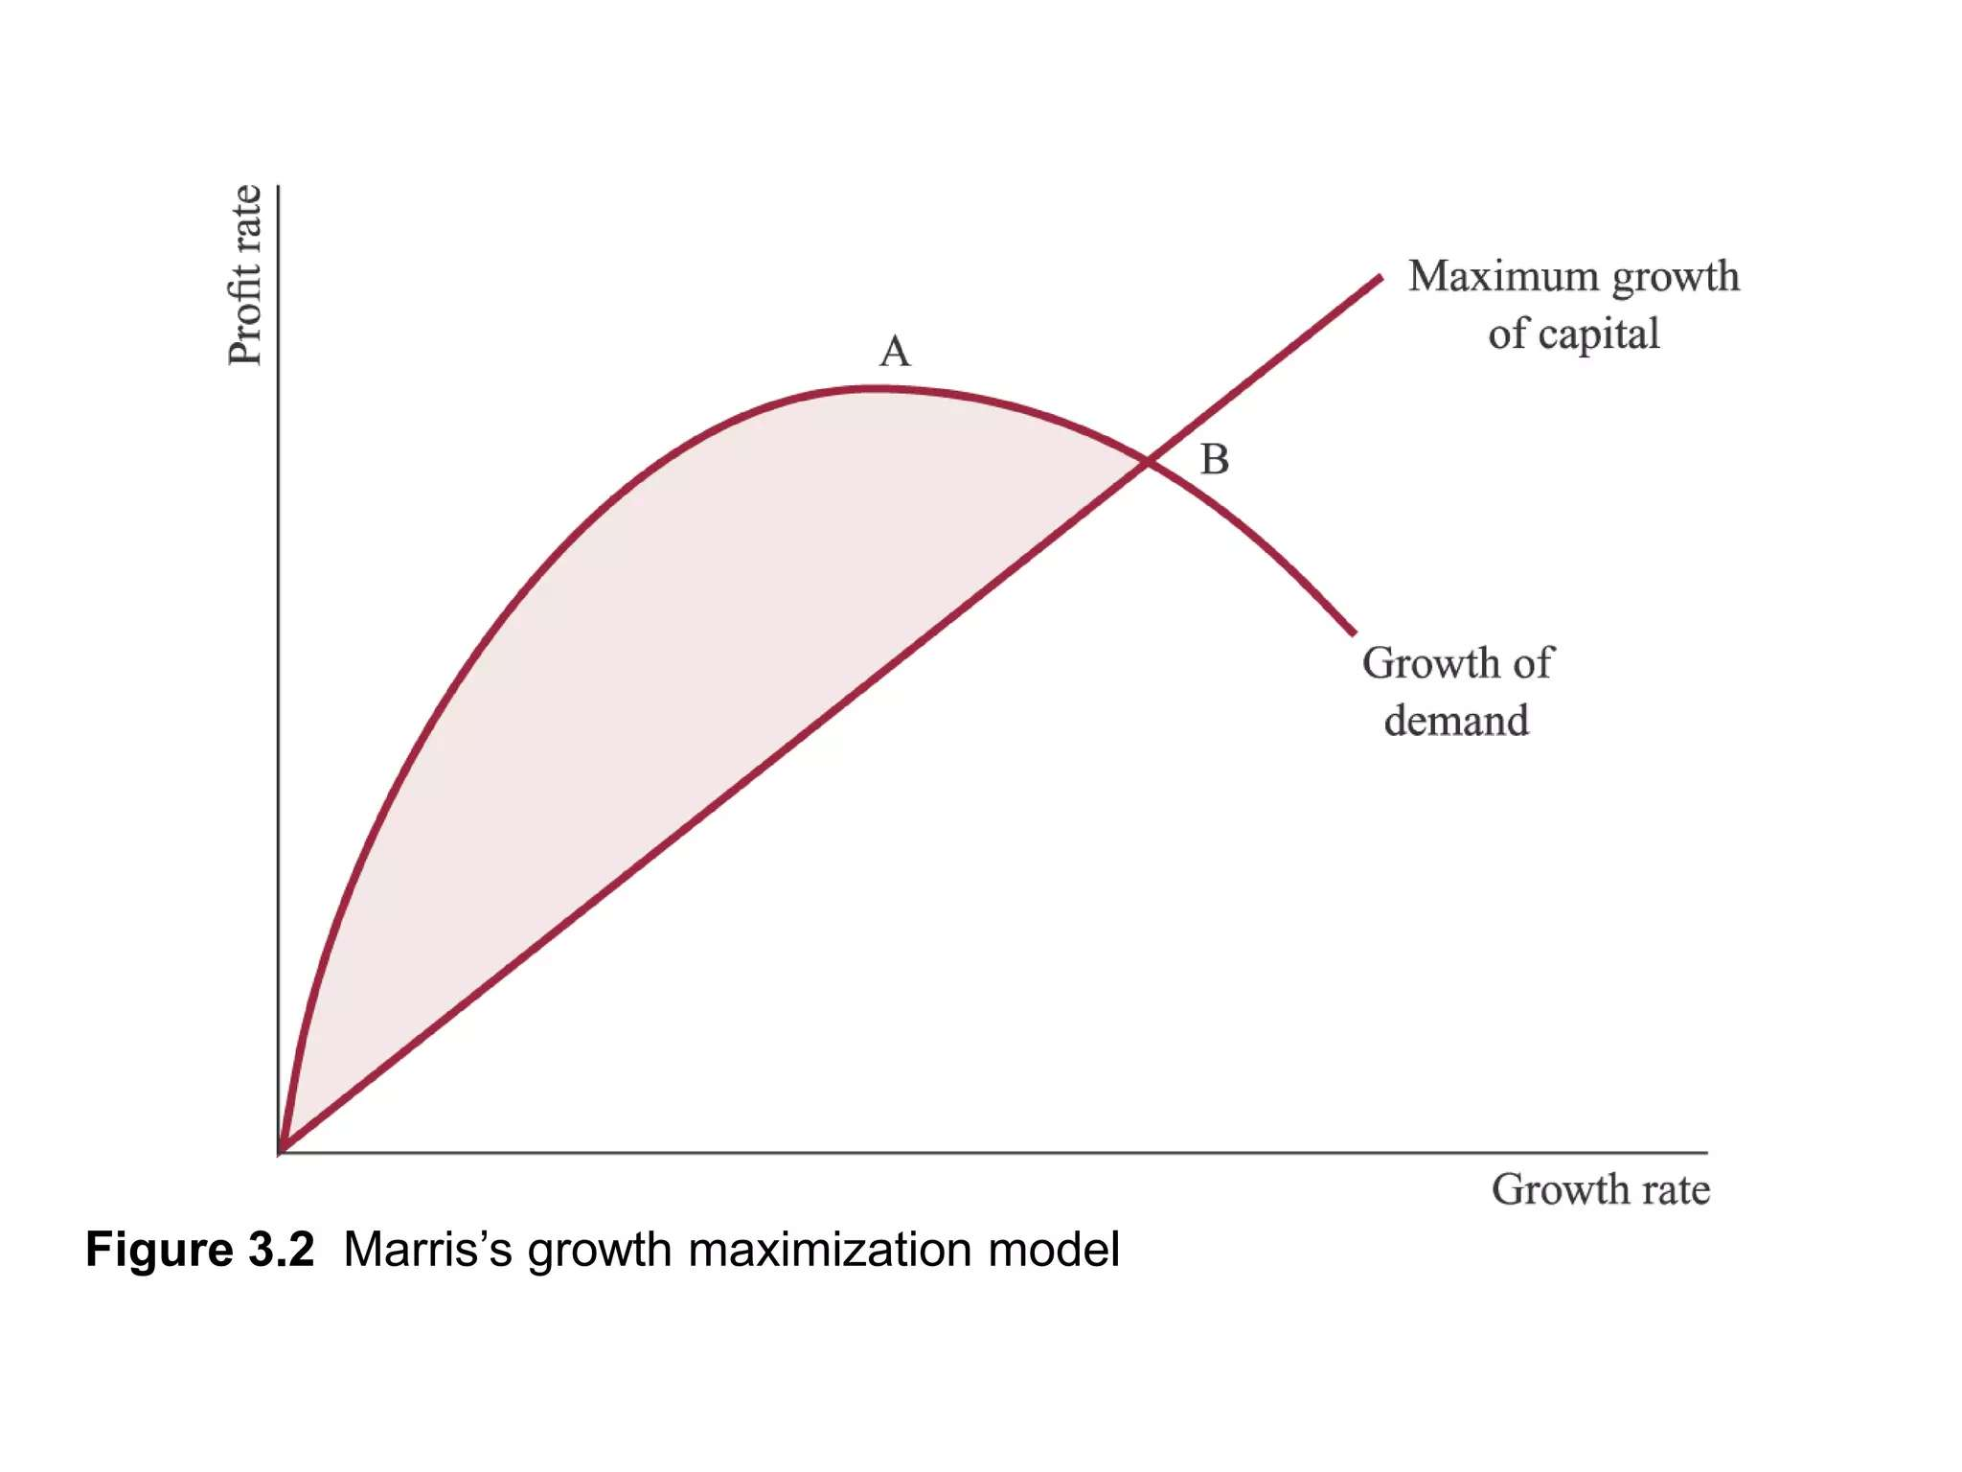

Slide 36
“gr=gd=gc”
gd​: Growth rate of demand of the firm’s products
gc​: Growth rate of capital supply (financial growth)
As the rate of growth of demand is increased, profitability is increased until a certain point. Then managerial constraints on growth tend to take place.
The maximum growth of capital function shows the relationship between the firm’s rate of profit and the maximum rate at which the firm is able to increase its capital.
This model is suggests several testable hypothesis one of which is “owner controlled firms achieve lower growth and higher profits”

Slide 37
Assumptions:
Separation of ownership and management – Managers run the firm; shareholders own it.
Managers aim to maximize the balanced growth rate of the firm.
Owners aim to maximize profits and share value.
The firm’s growth depends on:
Diversification of products,
Retention ratio (how much profit is reinvested),
Financial policies and dividend policies.
5. There is a trade-off between managerial utility (growth, job security) and shareholder utility (profit, dividends).

Slide 38
Weaknesses / Limitations
Assumes a Stable and Predictable Environment
Difficult to Measure Balanced Growth Rate
Ignores Competition and Market Structure
Overemphasis on Managerial Goals
Shareholders' Interests May Be Ignored
Unrealistic Assumption of Managerial Security
Assumes Managers and Shareholders Always Reach a Balance
Limited Applicability to Small Firms or Startups

Slide 39
Williamson’s Managerial Discretion Model
In modern corporations, managers (not owners) take most decisions.
Williamson argues that managers do not maximize profit, but instead maximize their own utility — which includes salary, job security, perks, staff, and discretionary expenditure.So, firms aim for “satisficing profits” instead of profit maximization.
The theory of Managerial Utility Maximization was developed separately by Berle-Means-Galbralth and Williamson. It is also known as Managerial Discretion Theory. The Theory is based on the concept that shareholders or owners of the firm and managers are two separate groups. The owners or the shareholders want high dividends therefore they interested in maximizing profits. The managers on the other hand, have different motives other than profit maximization. Once the managers have achieved a level of profit that will pay satisfactory dividends to shareholders and still ensure growth.
They are free to increase their own emoluments and also the size of their staff and expenditure on them. In the words of Williamson, “The extent that the pressure from the capital market and competition in the product market is imperfect. The manager therefore, has discretion to pursue goals other than profits."
Notes:
the freedom and power to make decisions by yourself

Slide 40
Further he suggested that "The lack of corporate democracy leaves owners or shareholders with little or no power to change corporation policy.“
He also argues that managers have discretion in pursuing policies which maximize their own utility rather than attempting the maximization of profits which maximizes the utility of owner or shareholders. The managerial utility function includes such variables as salary, security, power, status, prestige, professional excellence. In these variables only the first (salary) is measurable. The others are non measurable if they are to be operational they must be expressed in terms of other variables with which they are connected and which are measurable. This is attained by the concept of expense preference, which is defined as the satisfaction which managers derive from certain types of expenditures.
According to Williamson, "Managerial Utility function may be expressed as follows:
U = f (S, M. ID)
Managerial utility is a function (f) of additional expenditure on staff, managerial emoluments and discretionary investment. M = managerial emoluments. (Here, U = managerial utility; S = additional expenditure on staff; M = managerial emoluments and ID = discretionary investment).

Slide 41
Managerial utility function maximizes the utility of the managers rather than profits of the firm. The manager is expected to follow policies which maximize the following components of his utility function.
Expansion of Staff
Increase in Managerial Emoluments
Discretionary Power of Investment
According to the theory, in a firm, shareholders and managers are two separate groups. The firm tries to get maximum returns on investment and get maximum profit, whereas managers try to maximize profit in their satisfying function.
At last, Williamson’s managerial discretion theory shows the utility function of a manager. In this theory, the firm will try to get maximum returns or maximum profit where as manager try to maximum utility satisfying function. They are in equilibrium when the utility has maximum amount.

Slide 42
Assumption:
Separation of ownership and control
Managers maximize their own utility, not profit
Shareholders set a minimum profit constraint
Utility is linked to firm size
Managers have discretion in using firm resources
Market conditions allow some degree of monopoly power

Slide 43
Weaknesses / Limitations:
Unrealistic utility function
Ignores profit-oriented incentives
Minimum profit constraint is vague
Assumption of managerial freedom is exaggerated
Does not apply well to competitive markets
Empirical evidence is weak

Slide 44
Thank You

